Slide 1
The Squire

Slide 2
Perfect Squire’s Profession
14-21 years old
Knight-in-training
Accompanying knights to their tournaments and to the battlefield
Tending the knight’s horses
Helping out and taking care of the castle
-waiting tables
-running errands
-carrying messages
-guarding the knight while he sleeps
Learn the ways of knights
-swordsmanship
-horsemanship
-jousting

Slide 3
Perfect Squire’s Appearance
Now viewed as a young man
Clothing similar to knights
Rich colors and fabrics
In battle, often dressed in same color as knight

Slide 4
Perfect Squire’s Personality
Beginning to learn and act in accordance with the Chivalric Code (generous, brave, loyal)
Participates in courtly love
Learning the social life of the castle
-courtly etiquette (table manners)
-music
-dancing
Christian

Slide 5
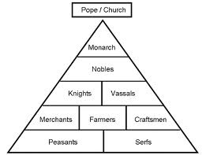
Social Class
Knightly class
Family would be part of the nobility

Slide 6
Chaucer’s Squire’s Profession
Involved in several battles in which he preformed fine in
“He’d seen some service with the cavalry…And had done valiantly” (87, 89)
Agile/Strong
Good horseman and jouster
“He knew the way to sit a horse and ride”
Courteous, lowly, serviceable
“And carved to serve his father at the table” (102)

Slide 7
Chaucer’s Squire’s Appearance
Curly hair that looks like he “did” it
20 years old
Moderate height
Short gown with long, wide sleeves & embroidered
“he was embroidered like a meadow bright/ And full of freshest flowers, red and white.”

Slide 8
Physiognomy
Curly hair in men meant that they were dutiful.

Slide 9
Chaucer’s Squire’s Personality/Character
Agile and strong
“With wonderful agility and strength” (86)
Lustful lover
“He slept as little as a nightingale” (100)
Wants to impress his lady
“In hope to win his lady’s grace” (90)
Youthful
“He was as fresh as in the month of May” (94)
Enjoys singing, whistling, dancing, drawing, and writing.

Slide 10
Satirical?
Yes and No
Yes
-described as more of a young boy (represented by the flowers), impure mind, no mention of Christian values or of his devotion to God
No
-displays all the qualities a squire should have had during that time
-seemingly ideal squire

Slide 11
Reason for Pilgrimage
To follow and assist his father (the Knight), and also to please his lady
Not religious

Slide 12
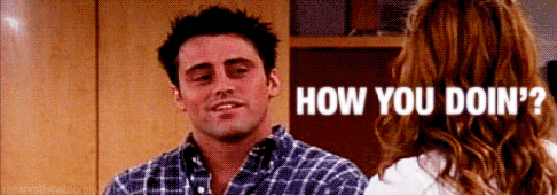
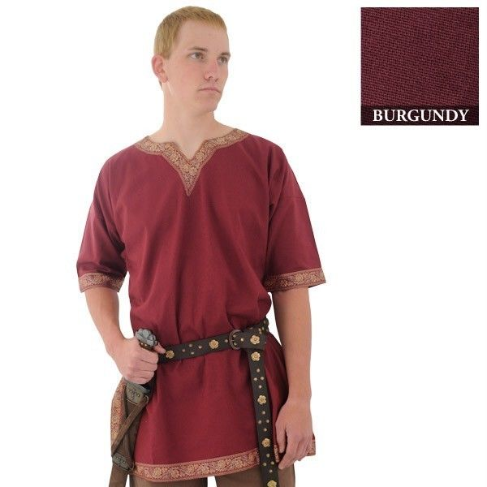
Symbol
Our young, courtly lover
Flowered tunic showing his youth and romance.

