Slide 1
Activity 1.6: Using Direct Quotes
There are 3 ways to use direct quotes. Some methods are more sophisticated than others. This PowerPoint will increase in sophistication throughout the slides.
At the end of this PowerPoint, you will need to demonstrate that you can use all three! Consider taking notes on page 31.

Slide 2
INCORRECT INTEGRATION
WRONG (NO INTRODUCTION): Macbeth has changed. "Out, out, brief candle!" (5.5.23).
It is no longer acceptable to not integrate at all! You are juniors and I KNOW you’ve gone over this since freshman year!
WRONG (NOT GRAMMATICALLY CORRECT): Macbeth has changed "Out, out, brief candle!" (5.5.23). ‘
Also, you can’t fool me into thinking you’ve integrated correctly by just eliminating the period!

Slide 3
1. Speaker Tags
This is the least sophisticated method of quotation integration.
Ex: de Crevecoeur said, “The American ought, therefore, to love this country much better than that wherein either he or his forefathers were born.” America deserves this love because it has given the new American sustenance and freedom.
Notice that this is integrated using a COMMA.

Slide 4
2. COLON
Macbeth wearily mocks the value of life: "Out, out brief candle!" (5.5.23).
A colon can work in two ways. It acts as an arrow drawing attention to what follows it. It can also act as an "equals" sign: a mark that something before and after it are equivalent.
Macbeth reacts with an expression of despair: "Out, out, brief candle!" (5.5.23).

Slide 5
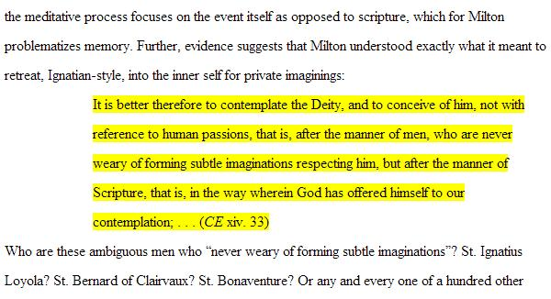
COLON
A colon is also used when integrating a BLOCK QUOTE. Notice the formatting:

Slide 6
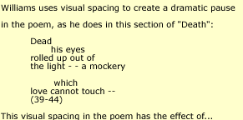
Block Quote- Poem

Slide 7
3. TRUE INTEGRATION- No punctuation
Grown fatalistic, he sees life as mere "sound and fury / Signifying nothing" (5.5.27-28).
WRONG: Grown heartless, he realizes that "I have almost forgot the taste of tears" (5.5.9).
RIGHT: Grown heartless, he realizes that he has "almost forgot the taste of tears" (5.5.9).

Slide 8
True Integration…
…requires you to modify the text to change it to fit your writing. Here are some rules on omissions and modifications:
An ellipsis marks omissions from a quotation.
EX: "Time's [. . .] chariot." This is helpful because too many block quotes is not acceptable. I only want to read what is necessary!
Use ellipses only to omit the middle of a sentence, not the beginning or end.

Slide 9
Modifying Quotes
Use brackets to set off changes within a quotation. You may need to clarify the reference of a pronoun or add a word to fit a quotation into your sentence.
EX: Suspicious, Polonius warns his daughter, "Do not believe his [Hamlet's] vows" (1.3.127).

Slide 10
Other important reminders:
Do NOT hit and run a quote. Every quote needs adequate quote analysis. Therefore, where should I never find a quote?
Avoid integration that includes “On page 34…” Instead, reference what was happening in the plot on those pages to give context.
Avoid explanation that includes “The book says…” or “It shows”

Slide 11
Continued…
4. Avoid “you,” this is improper. However, feel free to use “I” in a professional, sophisticated way.
5. Write in literary present tense if you are using a piece of literature as evidence.

Slide 12
Citation
For SpringBoard, write the author’s last name and the page number you’ve found the quote on.
EX: (Roosevelt 42)
If you are using a poem, they are cited using line numbers instead of page numbers. Also, poems have slashes to indicate the end of the line of poetry. Also, reproduce all capitalization and punctuation.
EX: Macbeth now sees life as a mere "tale / Told by an idiot, full of sound and fury, / Signifying nothing" (5.5.26-28).

Slide 13
Practice
I want you to practice integrating the following quote in all three ways:
“I have called for personal sacrifice, and I am assured of the willingness of almost all Americans to respond to that call. A part of the sacrifice means the payment of more money in taxes.”
-Can be found on page 44

